Slide 1

Chapter 5
Fundamentals of Geographical Information Systems
Notes:
This chapter presents the main concepts and terminology that students are required to understand Geographical Information Systems (GIS). The main data types are presented along with a discussion of relevant issues such as accuracy and precision. A brief overview of the development of GIS is given along with a flavour of the main software available. Using QGIS, we demonstrate how to prepare and manipulate some example GIS data. Where appropriate, we highlight the main issues that need to be considered when using a GIS and agent-based modelling.

Slide 2
Learning Objectives
By the end of this chapter, students will be able to:
Understand the main concepts and terminology required to understand Geographical Information Systems (GIS) and ABM.
The main data types along with issues pertaining to accuracy and precision.
To help with this a brief overview of the development of GIS
Sources for geographical data (including social media)
Using QGIS, we demonstrate how to prepare and manipulate some example GIS data and incorporate it into an agent-based model (see tutorial).

Slide 3
Introduction
Whatever occurs, occurs in space and time. Therefore our perception of the world is inherently spatial and temporal: objects have a location, and events are embedded in a stream of time. (Wegener, 2000)
Wegener, M. (2000). Spatial Models and GIS. In A. S. Fotheringham and M. Wegener (Eds.), Spatial Models and GIS: New Potential and New Models, pp. 3{20. London, UK: Taylor and Francis.

Slide 4
Introduction
Longley et al. (2010) note that a geographical information system (GIS):
‘is concerned with the description, explanation and prediction of patterns and processes at geographic scales’ and it’s a ‘computer-based system for storing and processing geographic information’.
GIS are used in all aspects of our daily lives
inventories on land use, identifying flood plains, deciding to where to place retail stores as well as in-vehicle navigation.
In simple terms, GIS allow us to store, organize, access and retrieve geographical information.
Longley, P. A., M. F. Goodchild, D. J. Maguire, and D. W. Rhind (2010). Geographical Information Systems and Science (3rd Edition ed.). New York, NY: John Wiley & Sons.

Slide 5
A (Very Brief) History of GIS
Early attempts at digital mapping can be traced back to Harvard’s Computer Graphics Lab SYMAP (symbol or synagraphic mapping) project in late 1960s.
The first GIS was the Canada Geographic Information System (mid-1960s) for land-use management.
DIME (Dual Independent Map Encoding) program developed by the US Bureau of the Census (late 1960s).
Digitized all US streets in order to facilitate the georeferencing and aggregation of US census records.
ESRI’s ARC/INFO (1982)

Slide 6
Representing the World
One of the central challenges with using a GIS centers around the question of how we represent the complexities of the world in digital form?
Specifically, geographic data that links place, time and attributes.
The most basic way of doing this is to deconstruct the world into two views: fields and objects.
Field-based views of space represent geographic phenomena that have a value (distribution) everywhere within geographic space.
Either as continuous (e.g. temperature, elevation, slope) or discrete (e.g. each cell as a specific class such as a specific land-cover class or soil type) representations.
Object-based view of geographic space is one where space is filled with discrete identifiable units (e.g. houses, lampposts) with well-defined boundaries (e.g. land ownerships).

Slide 7
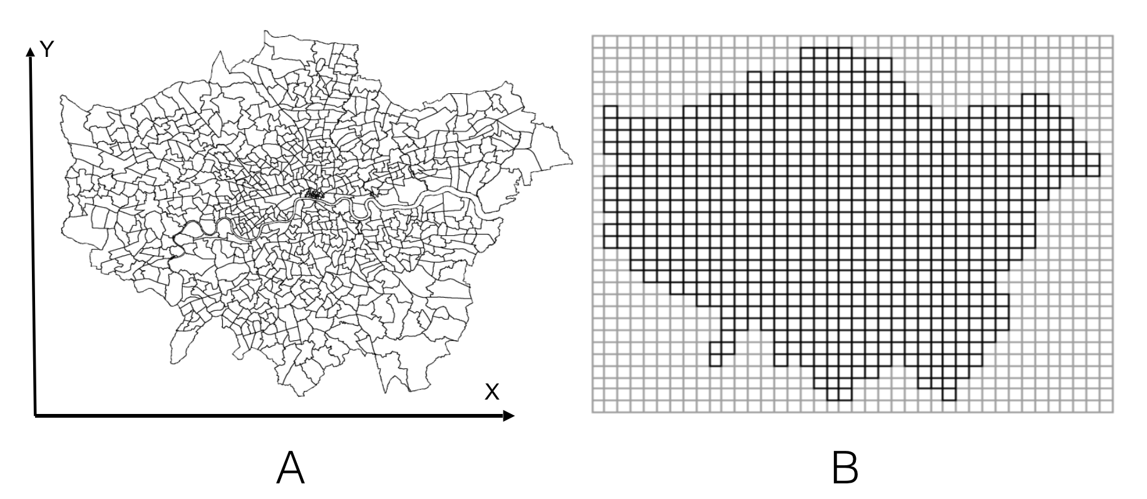
Representation: Vector & Raster Data Models
Figure 5.1: An Example of a Vector (A) and Raster (B) of Wards (administrative units) in the Greater London Authority area.

Slide 8
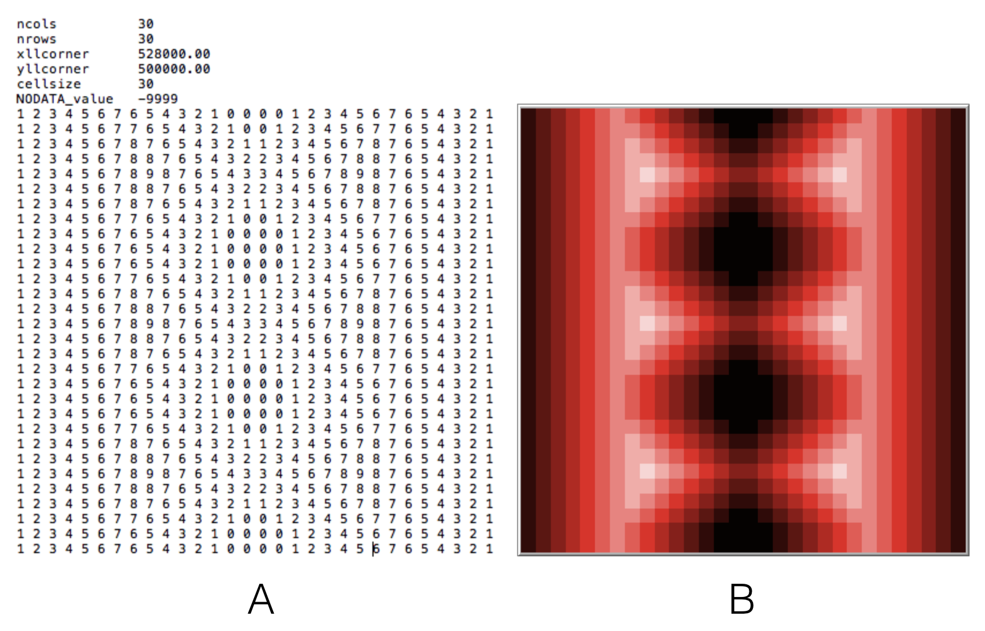
Raster Data
For the Model see ImportRasterSample
The raster data model uses an array of cells (typically square) to represent real-world objects. All geographic variation is then expressed by assigning properties or attributes to these cells.
Typical metadata includes the geographical coordinates of the upper left-hand corner of the grid, the cell size, the number of row and column elements, and the projection.
Figure 5.2: An Example of reading in a raster data and creating a landscape. (A) the original ASCII file from a GIS. (B): the resulting space created in NetLogo.
Notes:
Model example called ImportRasterSample

Slide 9
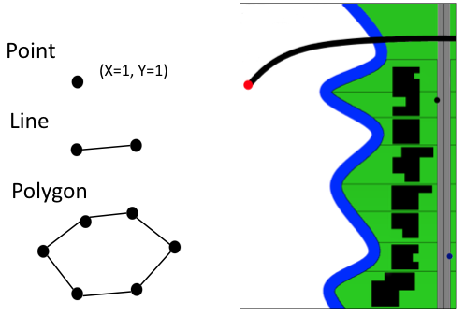
Vector Data
The vector data model is used to represent discrete objects with well-defined boundaries. The vector representation allows for variable resolution of objects.
Within the vector data model, each object is first classed as a geometric type: in the two-dimensional case, these are points, lines or areas (polygons)
Figure 5.3: The basic building blocks of vector data: Points, lines and polygons. Different types of objects can be combined to represent geometric properties of an area.

Slide 10
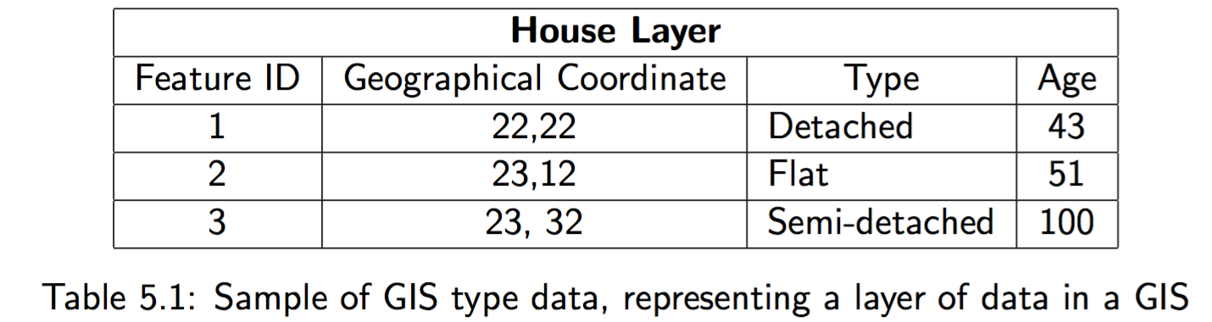

Slide 11
Time in GIS
GIS is not only about representing the world in a digital form but also quantifying and analyzing change over time.
Objects (such as people) and features (e.g. land cover, rural or urban) have one or more properties in time and space, and these are subject to change.
There are three approaches to capturing space-time information within a GIS: location-based, time-based and entity-based.
However, the only method of viewing a data model within an existing GIS, as a space-time representation, is as a temporal series of spatially registered ‘snapshots’

Slide 12
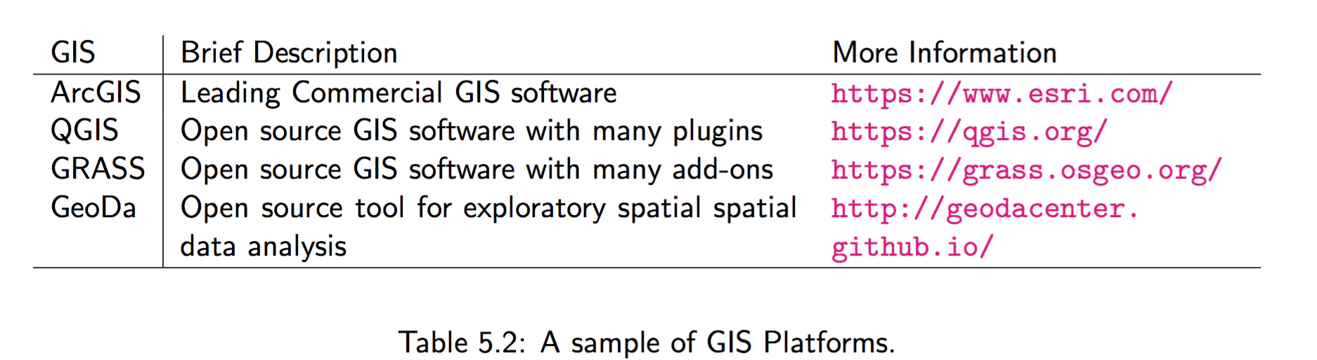
GIS Software

Slide 13
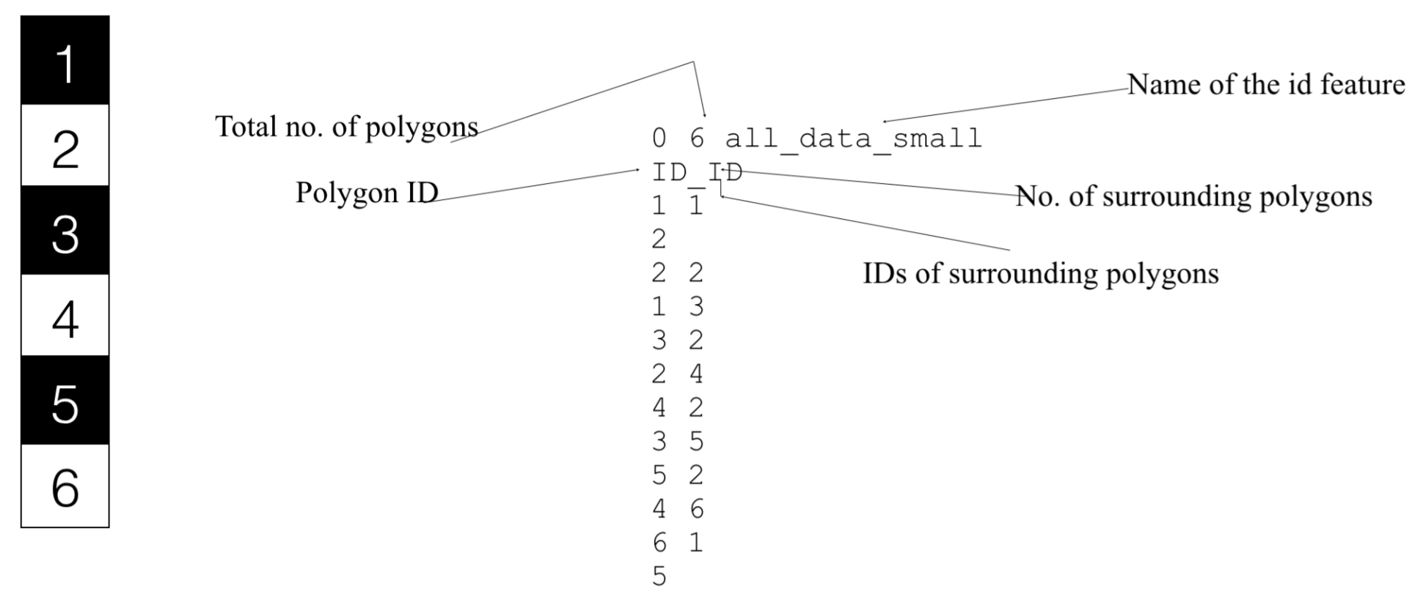
Using GeoDa to create a .GAL file
Figure 5.4: Using GeoDa to create a .GAL file. On the left we have a collection of polygons (objects) and right the the .GAL file where each polygon records its neighbors.
Notes:
(we use such an approach in Section 6.6).

Slide 14
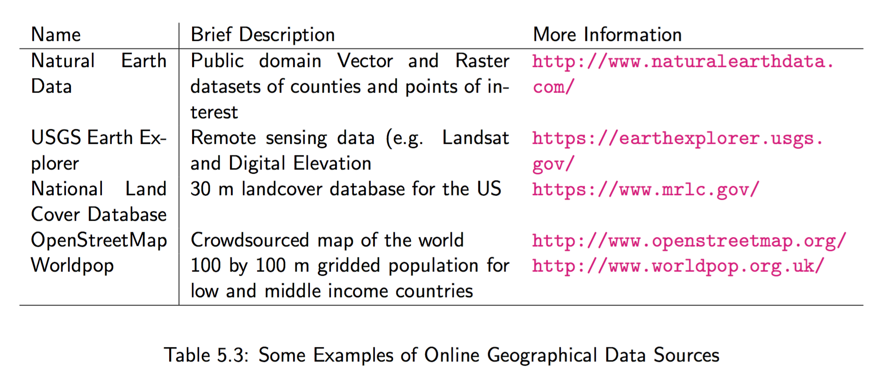
Sources of Geographic Data

Slide 15
Volunteered and Ambient Geographical Information
Traditionally data was centrally controlled however this has changed with a
The growth of crowd-contributed geographical data (often referred to as ‘crowdsourced’) can be largely attributed to either
Volunteered geographical information (VGI; Goodchild, 2007) where a crowd actively contributes geographical knowledge (e.g. OpenStreetMap, Wikimapia), or
Ambient geographical information (AGI, Stefanidis et al., 2013), where the data needs to be mined to derive geographical content (e.g. Twitter or Flickr).

Slide 16
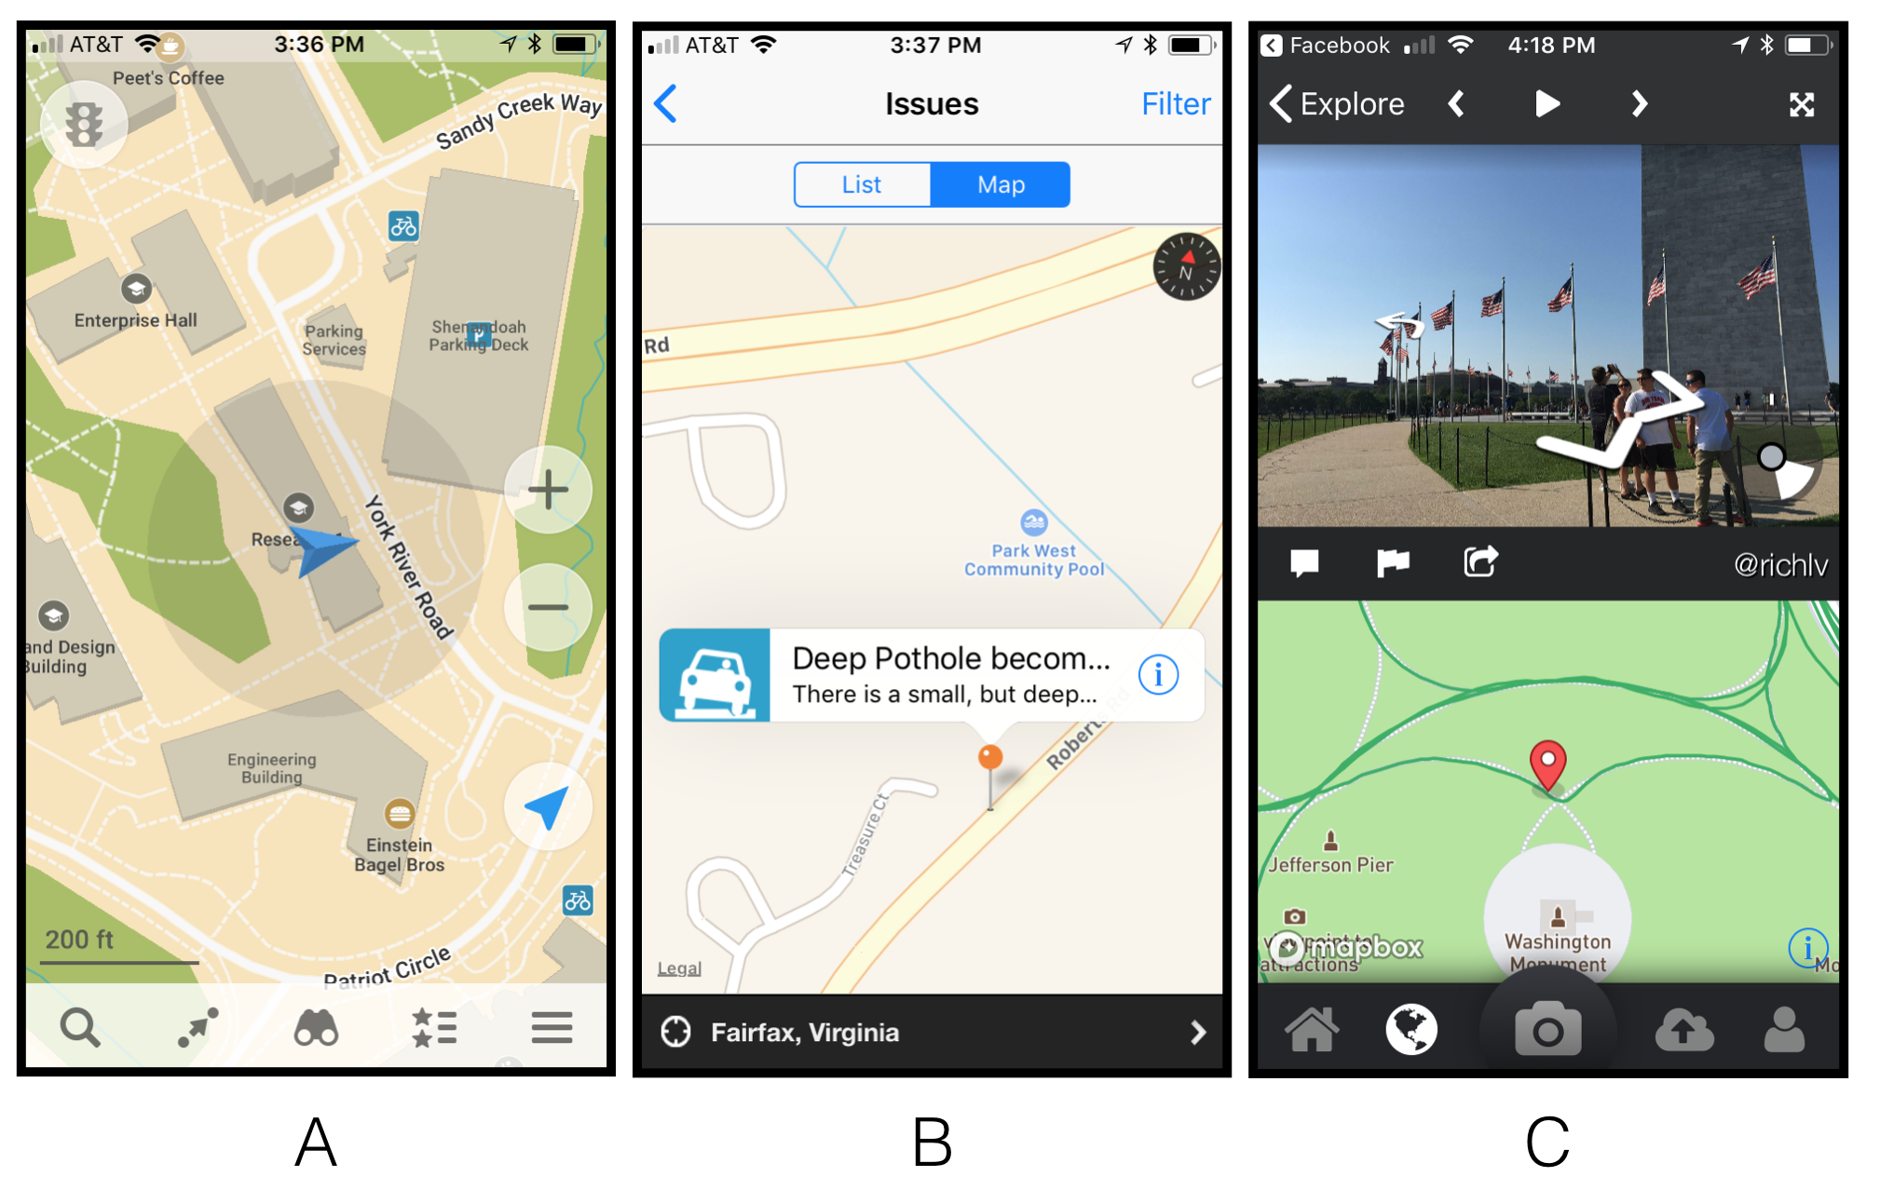
Representative examples of VGI
Figure 5.5: Examples of volunteered geographical information. A: Maps.Me, B: SeeClickFix C: Mapillary

Slide 17

GeoSocial Analysis
Figure 5.6: GeoSocial Analysis: linking places, people and events

Slide 18
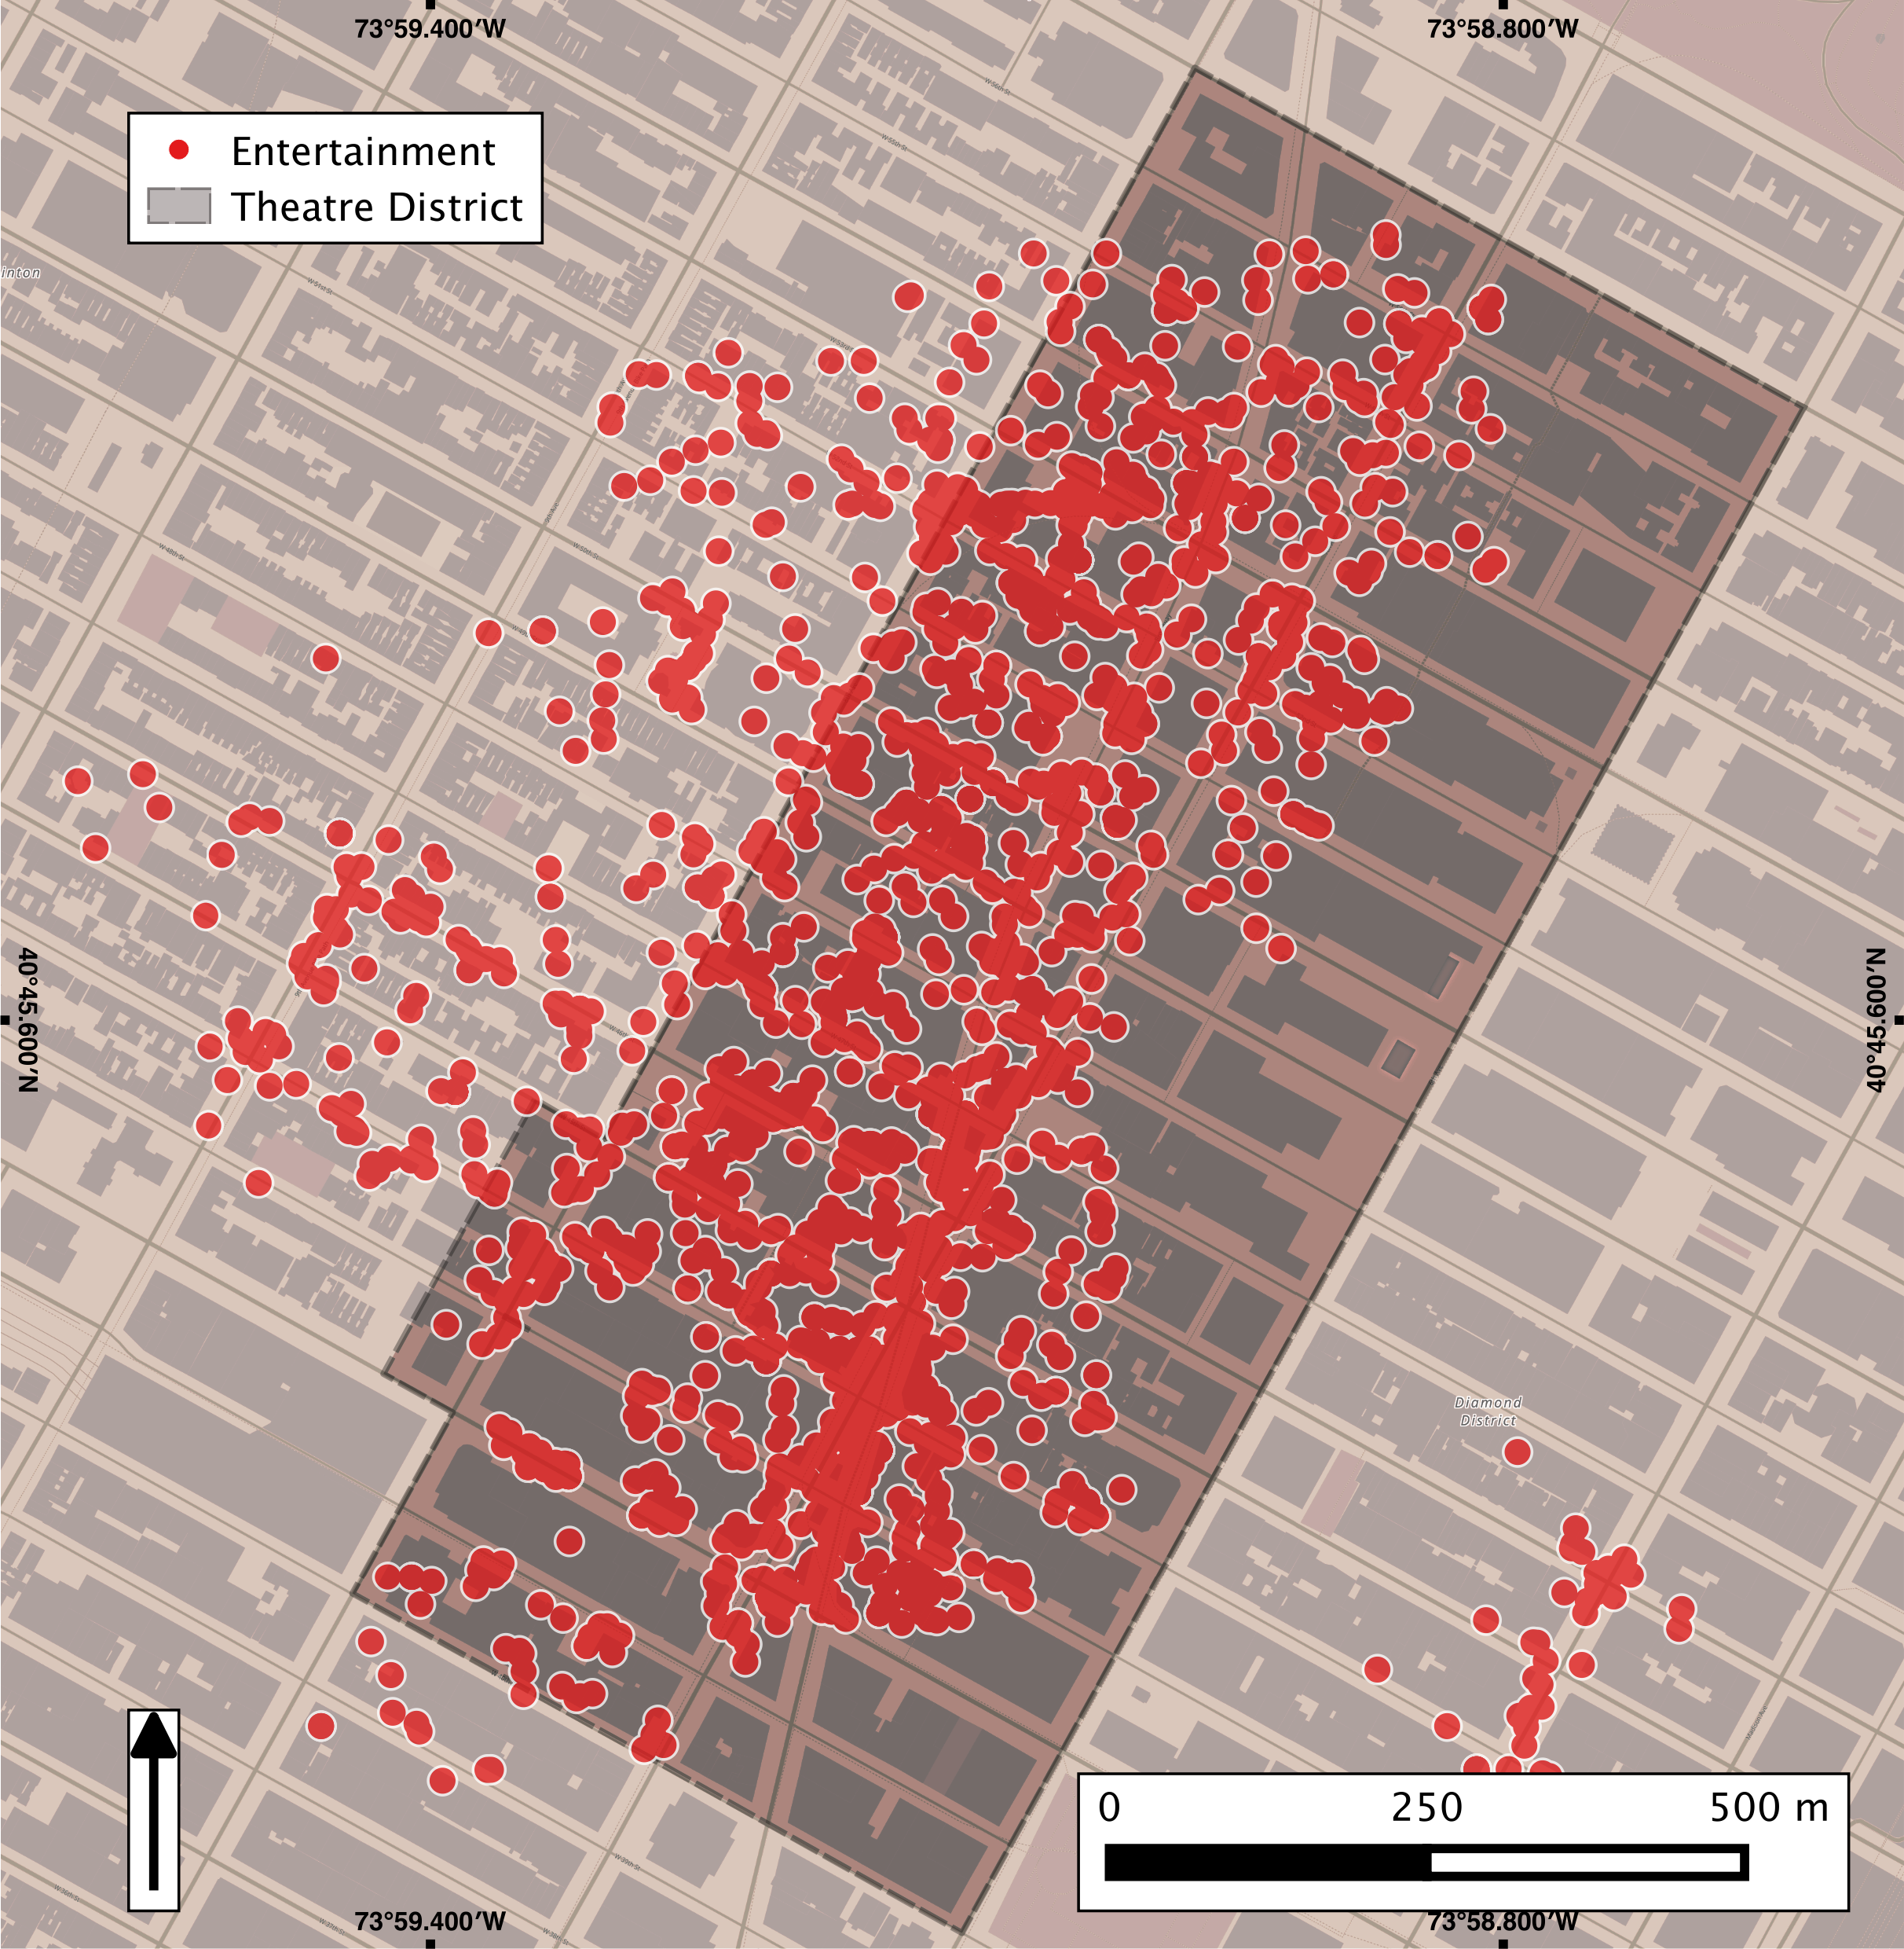
Deriving Information from Social Media (Twitter)
Figure 5.7: Mining tweets relating to entertainment and contained within and nearby the Theatre Sub District of New York city (Source: Jenkins et al., 2016)

Slide 19
Visualizing Results
Good-quality maps and visualizations not only explain the outcomes of the analysis, but also aid interpretation by allowing observers to easily draw out insights.
Any strong geographic visualization emphasizes and contextualizes the key trends found during the analysis.

Slide 20
Map Types
A choropleth map is a visualization of a spatial trend at the polygon level. The color of each polygon reflects the attribute of interest, often with the visually more intense colors indicative of higher values.
A point map visualizes the locations of point features over space.
Points represent features that can be linked to a specific coordinate, and that point may be associated with a value or set of values. The associated value, be it categorical (e.g. city status, station operator) or continuous (e.g. population, passenger count), can be visualized either through color intensity (like a choropleth) or variation in point size, or both.
Dot density map A combination of choropleth and point maps is found in the form of dot density maps. In these visualizations, a value captured through polygon-level aggregation is represented as a distribution of randomly located points within the bounds of the polygon, where each point feature represents a single count from the polygon data.

Slide 21
Map Types: Example of A dot Density Map
Figure 5.13: A dot density map of income distributions in Winnipeg, Canada, constructed from 2006 Census data.

Slide 22
Map Types (continued)
Lines: Where spatial data does not suitably align with a polygon or point representation, line maps are a necessary alternative. Lines can be visually manipulated for thickness and color to emphasize locations with high values.
Typical applications relate to transportation and network flows.
Density maps refer to the range of approaches for mapping distributions of values over space using a continuous surface. These are achieved through mathematical calculation of density or accumulation over space, yielding higher values in areas of higher density.

Slide 23
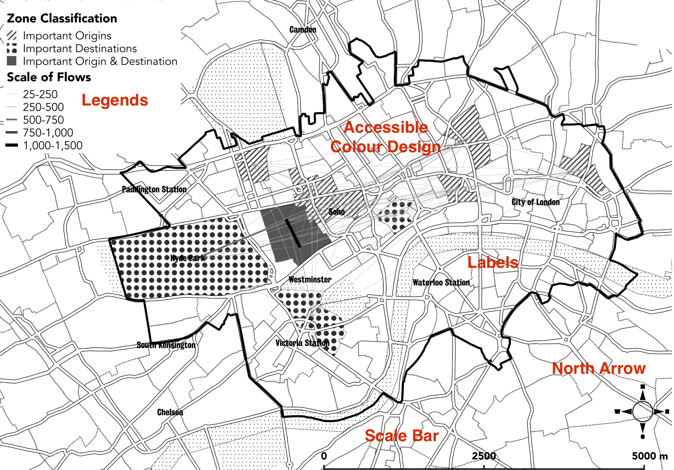
Map Elements
Legend
Scale bar
Labels
North arrow
Text
Graphs
Figure 5.14: Map from Demsar et al. (2018) that demonstrates strong map design, through inclusion of a legend, scale bar, supporting labels, north arrow, and accessible color design.

Slide 24
Discussion
Since their first appearance in the late 1960s, GIS has become a standard tool for researchers interested in manipulating and visualizing spatial data.
Increases in the availability of different forms of open source data, is beginning to transform the GIS industry.
While GIS can easily enable the manipulation, analysis and visualization of spatial data, they are limited by their inability to handle dynamic processes.
How and why we bring agent-based modelling and GIS together is the subject of the following chapter.
Notes:
Geographical Information Systems (GIS) are the mainstay of many researchers tool box. The ability to easily manipulate, analyse and visualise data makes it a powerful tool. However, researchers need to be aware of the underlying principles behind GIS, such as the data structures that are used and the limitations of GIS, in particular, its limited ability to handle and simulate dynamic processes. This Chapter has laid out the fundamental concepts that researchers need to be aware of, and presented an overview of the most common proprietary packages. A simple tutorial demonstrated how to bring data into a GIS and perform a simple spatial query. The next chapter will build upon this foundation and introduce the concept of coupling GIS with ABM.

Slide 25
Summary
Geographical information systems are the mainstay of many researchers’ toolbox. The ability to easily manipulate, analyze and visualize data makes them a powerful tool.
This chapter has laid out the fundamental concepts that researchers need to be aware of and presented an overview of the most common proprietary packages.

Slide 26
Further Reading
Lastly, for a more detailed discussion of all the techniques discussed in this chapter and their history, readers are referred to the following excellent resources:
de Smith, M.J., Goodchild, M.F. and Longley, P.A. (2009) Geospatial Analysis: A Comprehensive Guide to Principles, Techniques and Software Tools (3rd edn). Winchelsea: Winchelsea Press. See http://www.spatialanalysisonline.com/
To find out more about GIS, spatial analysis and modelling, along with the tools and methods one can use to explore geographical processes, readers are referred to:
Maguire, D.J., Batty, M. and Goodchild M.F. (eds) (2005) GIS, Spatial Analysis and Modelling. Redlands, CA: ESRI Press.
Readers wishing to know more about using open source GIS software (including QGIS), tutorials and data are referred to:
Graser, A. (2016) Learning QGIS. Birmingham: Packt Publishing.
Abernathy, D. (2016) Using Geodata and Geolocation in the Social Sciences: Mapping Our Connected World. London: Sage.
Online tutorials and documentation: https://www.qgis.org/en/docs/index.html and https://www.qgistutorials.com/en/

Slide 27
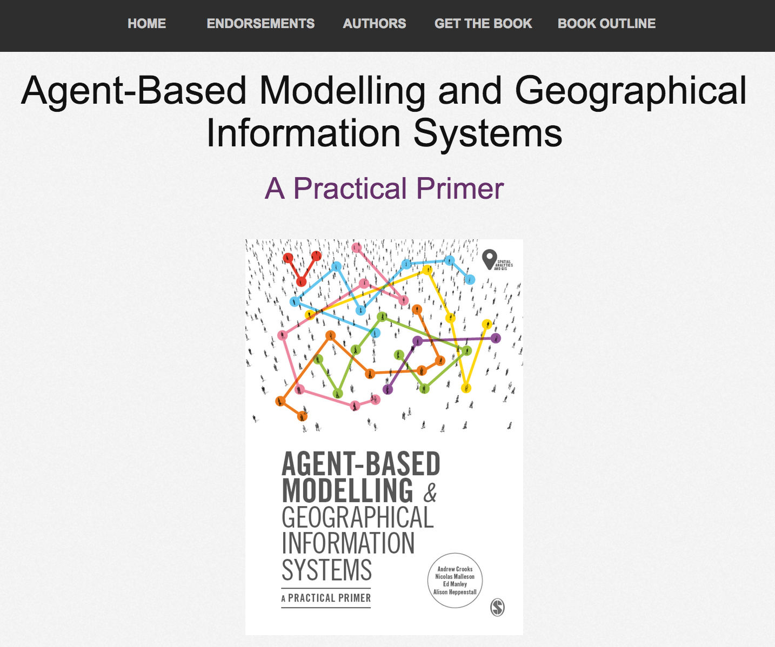
Online Resources
Visit: https://github.com/abmgis/abmgis/tree/master/Chapter05-GIS for a selection of models to highlight core concepts introduced in this chapter along with a tutorial.

